Slide 1


Successful and sustainable solutions in urban mobility
Latin American contexts
Context
Prescribed solutions
Rapid Urbanization and Motorization
Inadequate infrastructure
Old Vehicle Fleets
Social inequalities
Zero and Low-Emission Technologies
Public Transit
Active Mobility
Demand Management
Transit Oriented Development
Main concerns
PM2.5​, NO2​, and CO
We require multi-pronged approach that combines policy, technological innovation, and public engagement
But also,
How should social inequalities be a central factor in developing solutions for traffic-related air pollution, given that vulnerable communities often bear the greatest burden?
Source Addressing urban transport-related air pollution in Latin America: Insights and policy directions: https://doi.org/10.1016/j.latran.2025.100033
Webinar: Understanding Short-Lived Climate Forcers for Improved Air Quality and Climate Information

Slide 2

African Clean Air Program (ACAP) : toward reducing Short-Lived Climate Forcers for an improved Air Quality and Climate in Africa
N’datchoh E. T
University Felix Houphouet-Boigny Abidjan-Cocody
Ndatchoh.toure01@ufhb.edu.ci
September 4th 2025
ACAP core team

Slide 3
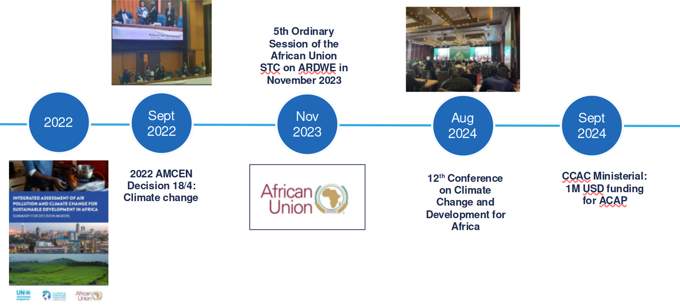
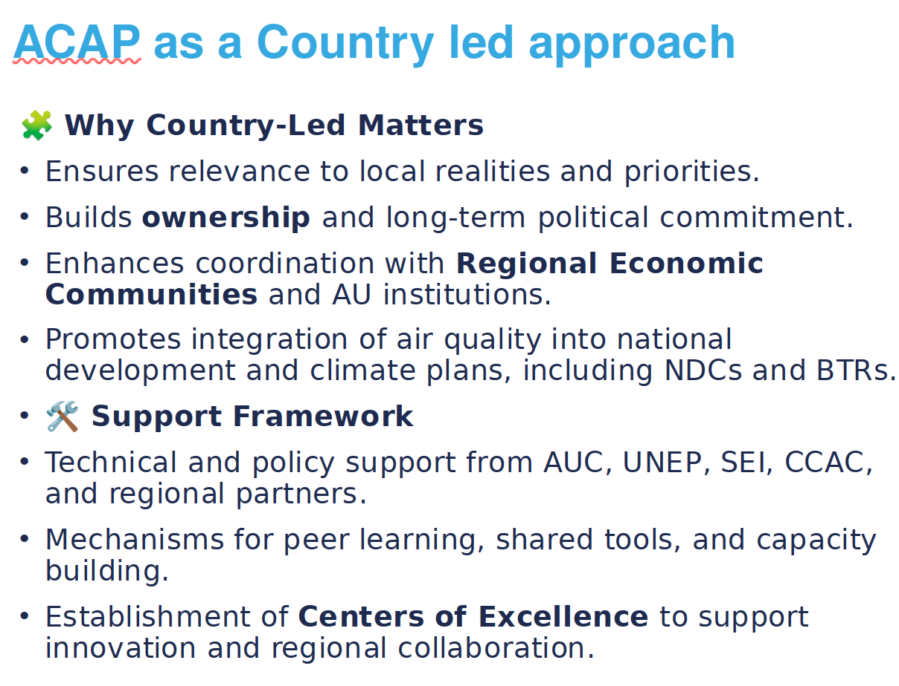
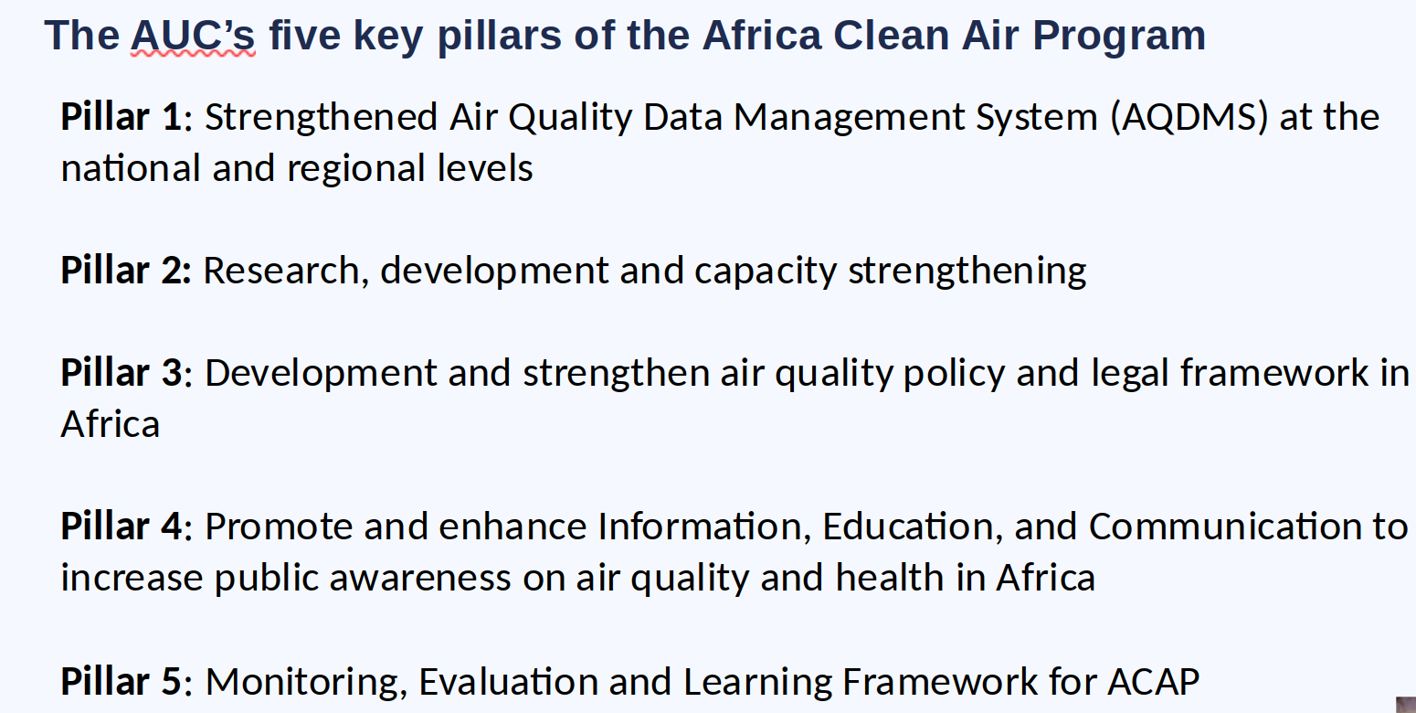
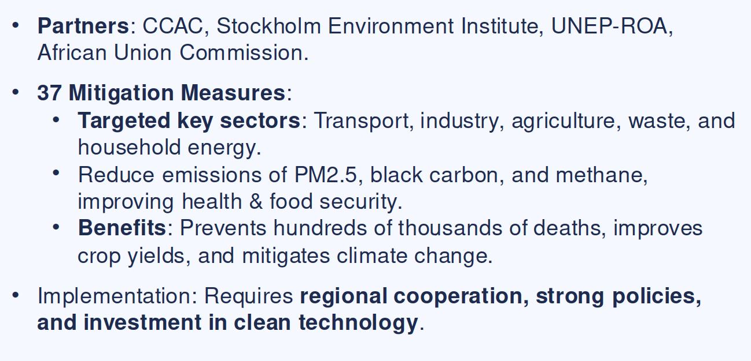

Slide 4
