Slide 1
THE FOCI PROJECT:
NON-CO2 FORCERS AND THEIR CLIMATE, WEATHER, AIR QUALITY AND HEALTH IMPACTS
Understanding Non-CO2 Radiative Forcers for Improved Air Quality and Climate
Sandro Finardi (ARIANET), Tomas Halenka (CU), Ranjeet S. Sokhi (UH)
FOCI International Clean Air for Blue Skies Day Webinar
04 September 2025 | Online

Slide 2
Non-CO2 or Short-lived Climate Forcers (SLCFs)
What are short-lived climate forcers?
SLCFs are substances that affect climate and are, in most cases, air pollutants. They include:
aerosols or particulate matter (PM) components (SOA, SIA, BC, mineral dust and sea spray),
chemically reactive gases (CH₄, O₃, NO₂, CO, VOCs, SO₂, NH₃, halogenated compounds).
Why are they important as climate forcers?
SLCFs are either radiatively active or precursors of radiatively active compounds through atmospheric chemistry. They can have either cooling or warming effects.
Well mixed CO₂ impacts are understood with high confidence level, while there are knowledge gaps concerning the impact of non-CO₂ radiative forcers
What do their features imply?
SLCFs effect occurs predominantly in the first two decades after their emission/formation
The return time of emission reduction policies is expected to be much shorter than for CO₂
Due to their short lifetime, they can have regional impact

Slide 3
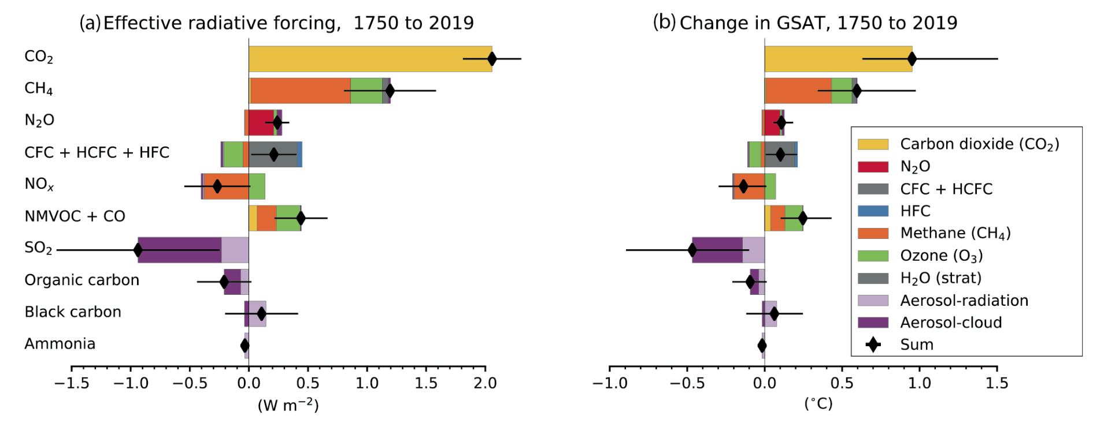
SLCFs radiative forcing and temperature response
GHGs
SLCPs
Figure 6.12 | Contribution to effective radiative forcing (ERF) (a) and global mean surface air temperature (GSAT) change (b) from component emissions between 1750 to 2019 based on CMIP6 models (Thornhill et al., 2021b).
Figures from IPCC AR6 WGI, Section 6: Short-Lived Climate Forcers

Slide 4
Air Pollution and Climate links, mitigation measures interaction
“Air quality and climate change represent two sides of the same coin, addressing both issues together could lead to significant synergies and economic benefits while avoiding policy actions that mitigate one of the two issues but worsen the other” (IPCC AR6)
Controversial measures:
Wood burning has been considered as carbon neutral but it emits air pollutants (in particular PM) with higher EF that other fuels.
decreasing the amount of sulphate aerosols improves air quality but results in a warming influence on the climate
Diesel cars penetration in Europe due to supposed lower CO₂ emissions than petrol car increased NOx and PM emissions
Policies improving air quality and limiting climate change:
energy efficiency measures
methane capture/recovery from the oil and gas industry and solid-waste management
zero-emissions vehicles, filtering of soot for diesel vehicles
efficient and clean stoves for heating and cooking
reducing agricultural waste burning and emissions
von Schneidemesser, E. et al., 2015: Chemistry and the Linkages between Air Quality and Climate Change. Chemical Reviews, 115(10), 3856–3897

Slide 5
Project FOCI
The overall aim of FOCI is to improve our knowledge of individual and cumulative contribution to climate change of non-CO₂ radiative forcers and their precursors
Global scale Earth System Models analysis of the impact of SLCF emitted during past and future periods
Assessment of Regional Climate Models during the last part of the historical period

Slide 6
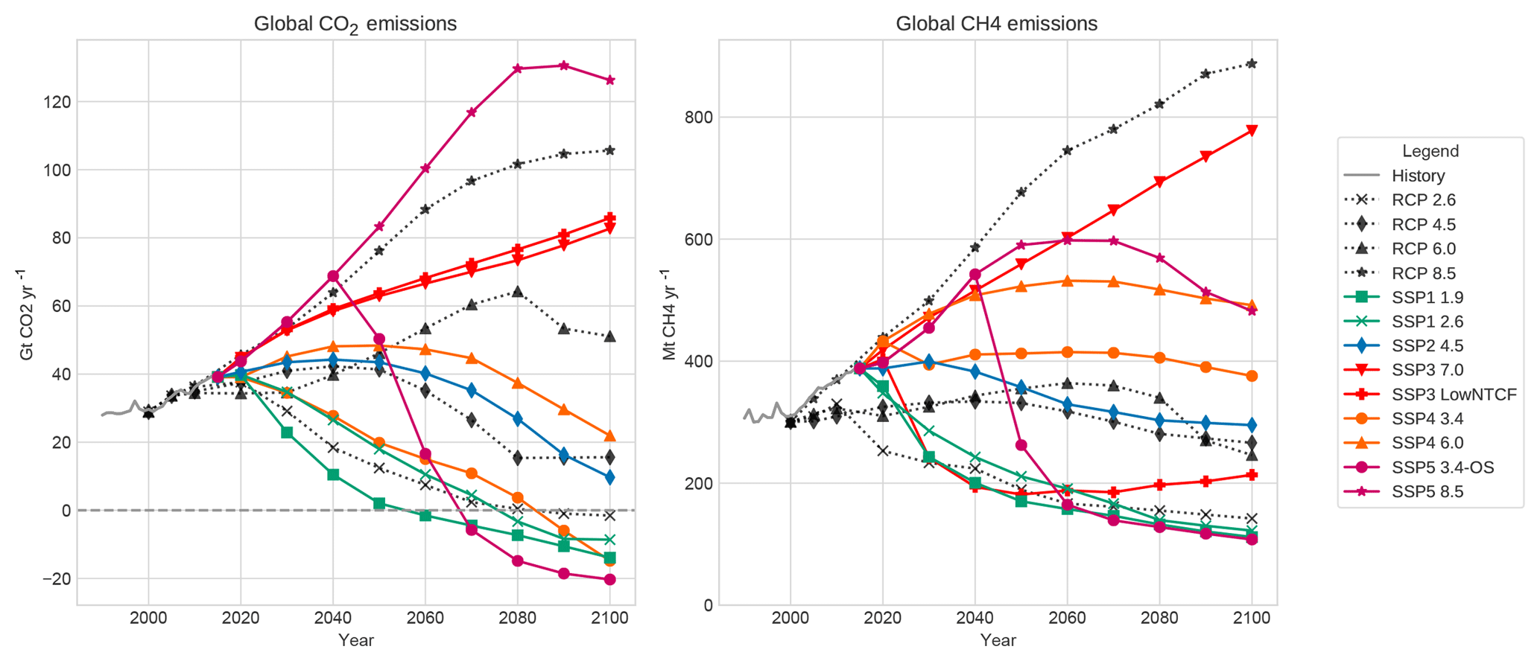
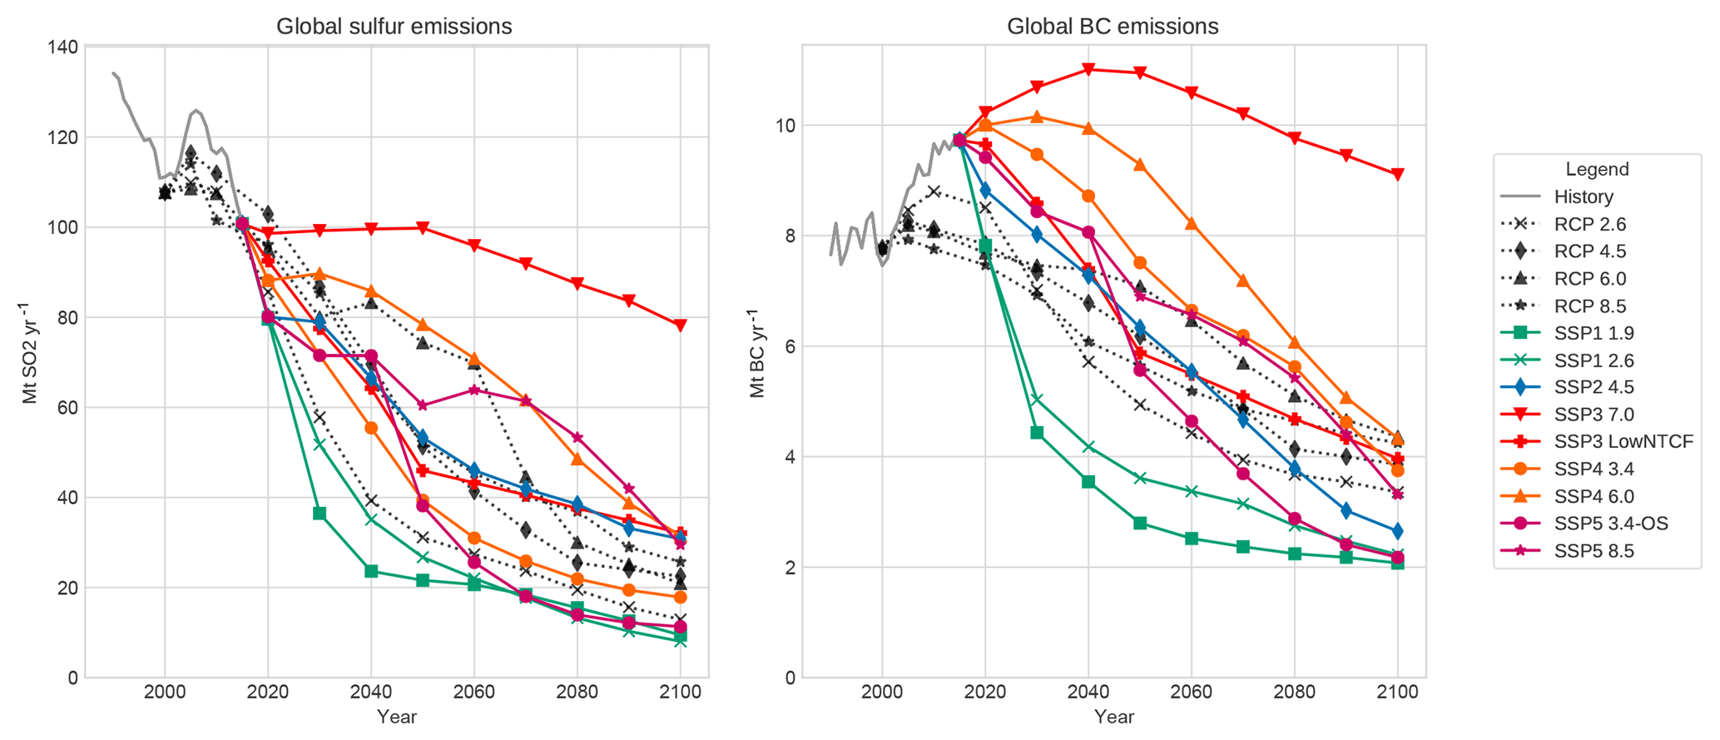
Considered emission scenarios: historical and future predictions
Historical period:
To assess the impacts of SLCF emissions on the recent past historical and hist-piNTCF CMIP6 experiments are compared. hist-piNTCF fixes anthropogenic, non-methane NTCF emissions at pre-industrial 1850 values.
Future Shared Socioeconomic Pathways (SSPs) scenarios:
To determine how SLCFs can impact climate in the near future ssp370 and ssp370-lowNTCF are compared. They have similar CO₂ emissions whereas in ssp370-lowNTCF, NTCF emissions follow a stronger pollution control.
Figures from: Gidden et al. 2019, Global emissions pathways under different socioeconomic scenarios for use in CMIP6, Geosci. Model Dev., 12, 1443–1475
SSP 3.7.0 Regional Rivalry – A Rocky Road (High challenges to mitigation and adaptation)

Slide 7
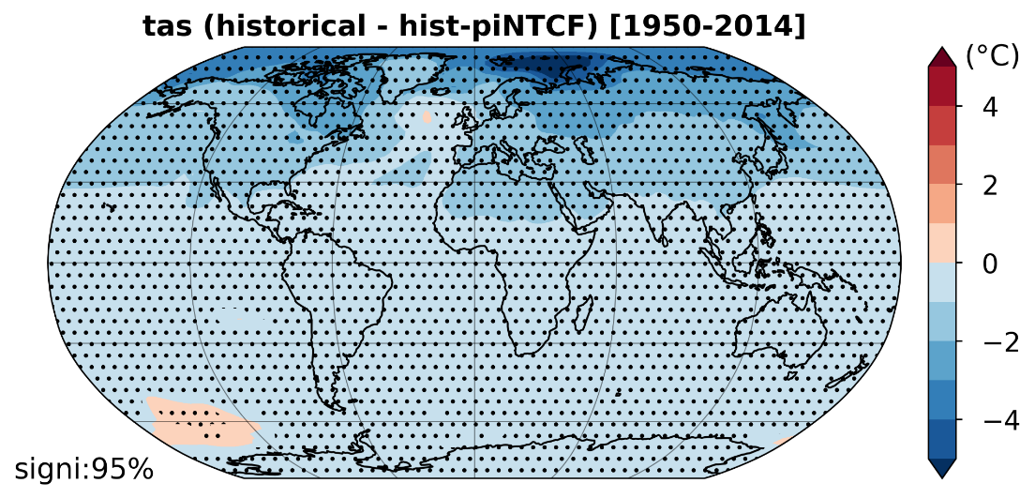
FOCI: preliminary results from global ESMs simulations
Historical period:
During the recent historical period (1950-2014), non-methane NTCFs have exerted a prevailing cooling effect due to aerosols
Non-methane NTCFs contributed to increase the Atlantic Meridional Overturning Circulation (AMOC) strength according to our multi-model analyses.
Surface air temperature response to historical NTCFs. Map shows the difference in tas climatologies between historical and hist-piNTCF experiments from a 4-model CMIP6 ensemble (BCC-ESM1, MRI-ESM2-0, UKESM1-0-LL, EC-Earth3-AerChem; 3 members each). Stippling indicates statistical significance at 95% confidence level (paired t-test).
Future period:
The effect of future NTCF mitigation policies on climate tipping elements are still uncertain.
Multimodel analyses comparing future scenarios with strict/lenient air quality policies revealed a general AMOC weakening under stricter NTCF emission policies, amplifying the greenhouse gas-driven AMOC decline.
The responses exhibit substantial inter-model differences, and no model reached a tipping point during the study period (2025-2054).
Courtesy of A. Santos-Espeso, M. Gonçalves, P. Ortega and O. Jorba (BSC), FOCI Deliverable 6.3 Report

Slide 8
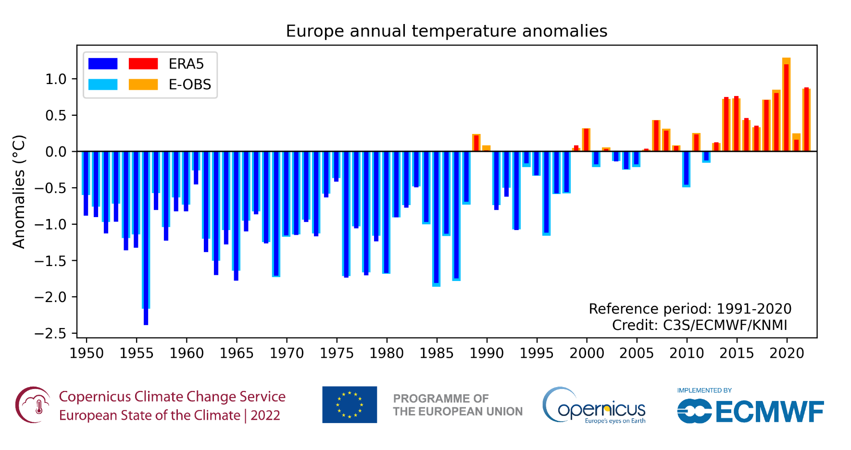
FOCI historical simulation 2004-2019 and regional models assessment
Time period for model evaluation and historical conditions analysis
2004-2019
15+1 recent years (before covid-19)
Including:
last 10 years of CMIP7 forthcoming historical simulations (2010-2019)
last 10 years of CMIP6 historical simulations (2005-2014)
CMIP = Coupled Model Intercomparison Project

Slide 9
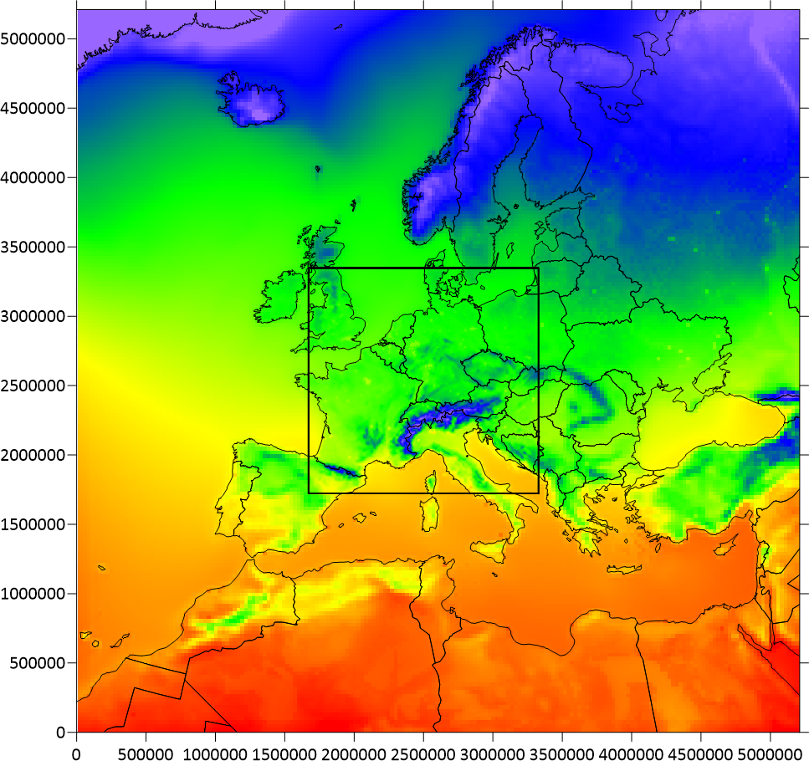
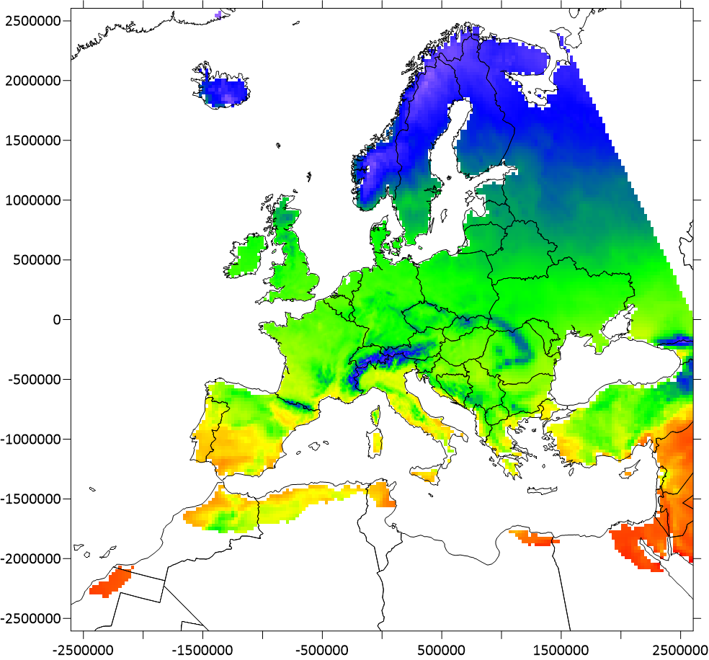
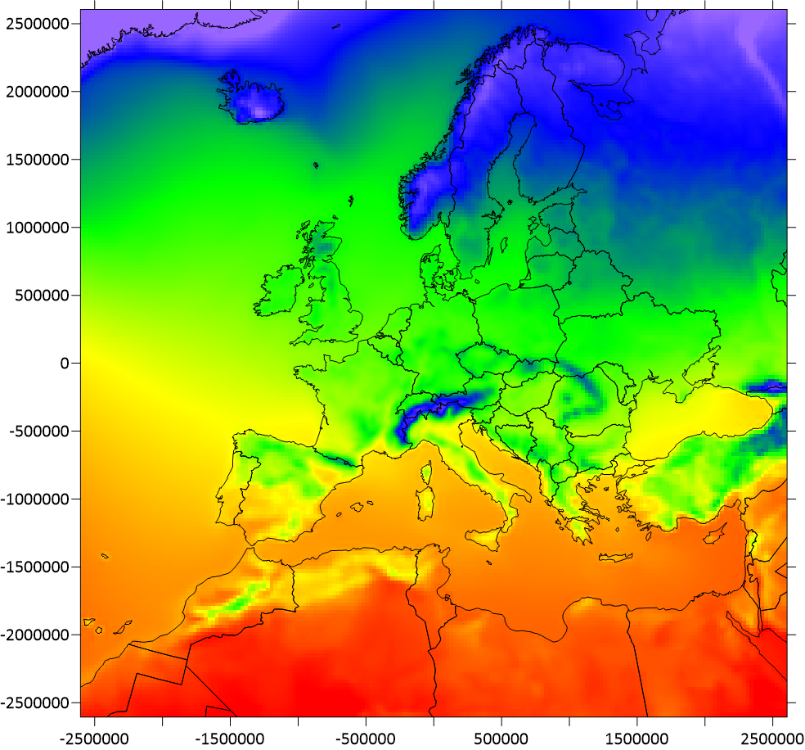
WRF evaluation with reanalyses for historical simulation (2005 to 2019)
T2m 15 years mean (comparison with existing reanalyses)
WRF
E-obs
ERA5
FOCI simulation
Reference reanalyses

Slide 10
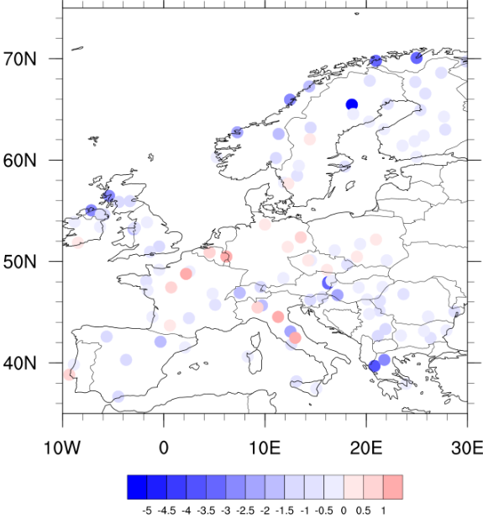
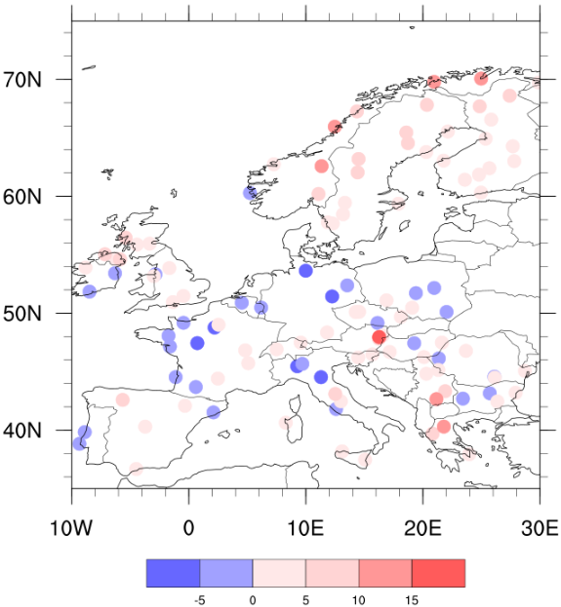
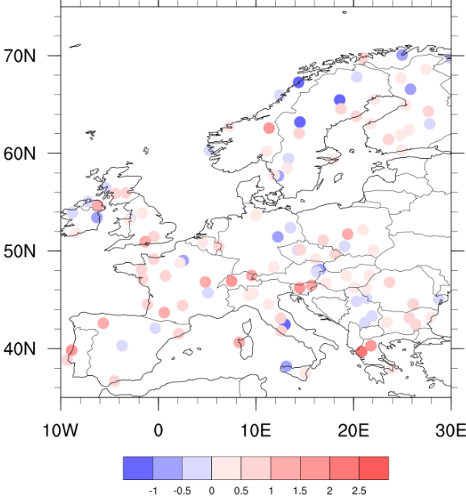
WRF evaluation with METAR obs. for historical simulation (2005 to 2019)
Difference between WRF and Observations (15 years averaged data)
for 115 stations over European domain (d01)
T2m (°C)
RH (%)
WS (ms⁻¹)
Observation source:
IEM :: Download ASOS/AWOS/METAR Data
https://mesonet.agron.iastate.edu/request/download.phtml
Courtesy of S. Arghavani, U. Alyuz, R. Sokhi (UH), FOCI WP4

Slide 11
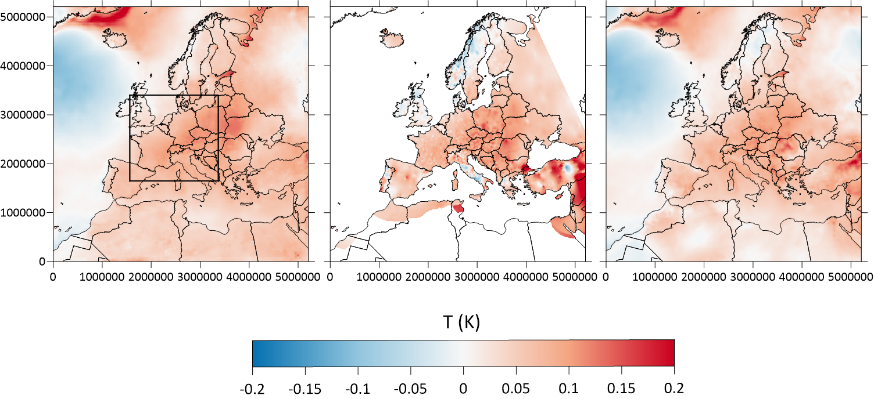
WRF evaluation with reanalyses for historical simulation (2005 to 2019)
2005-2019 T linear trend (C/year)
WRF
E-obs
ERA5
FOCI simulation
Reference reanalyses

Slide 12
Concluding remarks
The knowledge of processes involving SLCFs and their impact on climate, air quality and health need to be improved
Climate change and air quality mitigation policies need to be coordinated to maximize benefits and reach a win-win strategy
Present knowledge shows that industrial period SLCF emissions had a prevailing cooling effect mainly due to aerosols and strengthened the AMOC circulation
The future joint impact of SLCPs emissions shows uncertainties especially for their impact on climate system tipping elements
FOCI project overall results expected to be completed in about one year

Slide 13
Thank you for your attention!
FOCI presentations at the forthcoming EMS and HARMO conferences Sept. 2025
https://www.ems2025.eu/
https://www.conferences.uni-hamburg.de/event/602/
Acknowledgements
This project has been co-funded by the European Union with funding from the European Union’s Horizon Europe research and innovation programme under grant agreement No. 101056783 and from UKRI under the UK Government’s Horizon Europe Guarantee (UKRI Reference Numbers: 10040465, 10053814 and 10050799)

