Slide 1

Global trends and distribution of atmospheric methane and black carbon
FOCI webinar
Dr Oksana Tarasova (otarasova@wmo.int)
WMO Infrastructure Department

Slide 2

Drivers of climate change
In order of effect, water vapor, carbon dioxide (CO₂), methane (CH₄) and nitrous oxide (N₂O) are the most important GHGs.
Increases in concentrations of CO₂, CH₄ and N₂O due to human activities are the primary drivers of observed climate change (IPCC, 2021).
Impact is defined by the amount of the gases in the atmosphere and their warming potential

Slide 3
Atmospheric CH₄ and Black Carbon as “super pollutants”
Compound | Life time in the atmosphere | Warming potential | Impacts
Atmopsheric methane (CH₄) | 12 years | 83 (20-years) | Climate Human Health Agriculture and ecosystems
Black Carbon | 4-12 days | 4470 (20-year) | Climate (direct and indirect) Human Health Agriculture and ecosystems

Slide 4
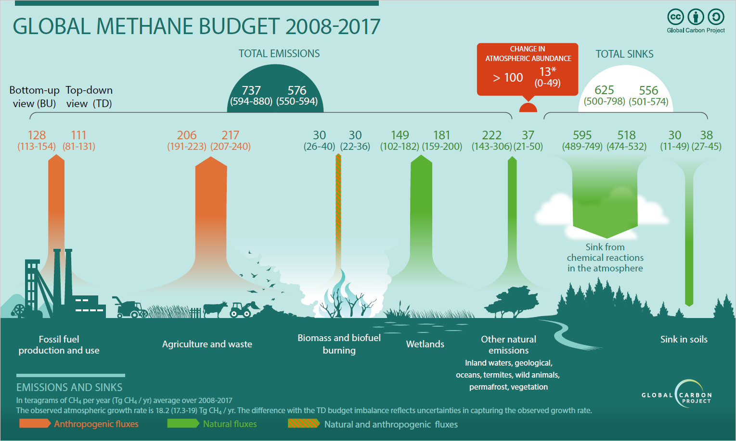
CH₄ annual budget (average 2008-2017)
Methane accounts for about 16% of the radiative forcing by long lived greenhouse gases
Main sources: 40% natural, 60% anthropogenic
Many sources of methane are sensitive to climate change
Amount of methane in the atmosphere can be measured with the gas analysers

Slide 5
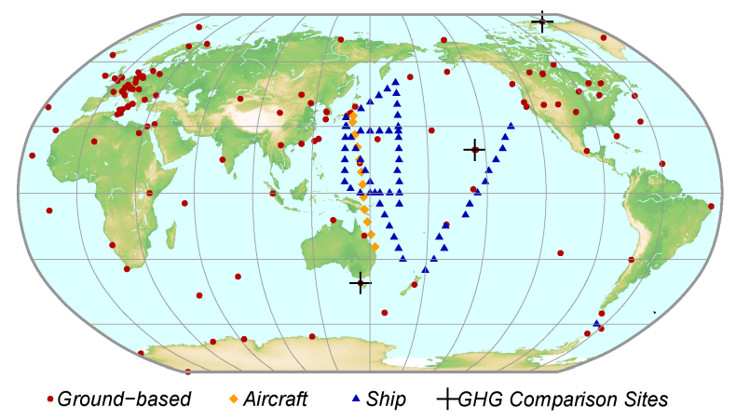
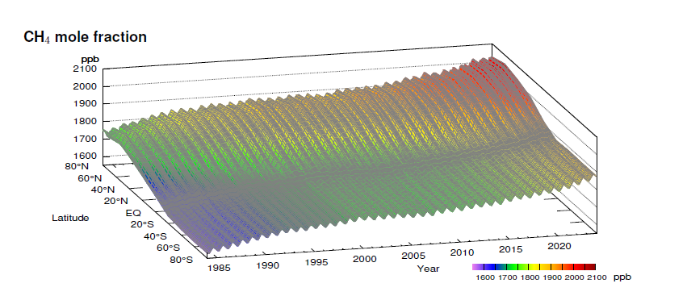

Global observations of atmospheric methane
WMO Global Atmosphere Watch Programme provides long-term (since 1989) coordination of the global observational network stations performing of high-quality measurements of greenhouse gases;
About 140 stations contribute data to global analysis which is included in the annual greenhouse gas bulletin
Long-term GHG observational data are openly available in the World Data Center for Greenhouse Gases supported by Japan Meteorological Agency
Notes:
Geographical gaps in observing network

Slide 6

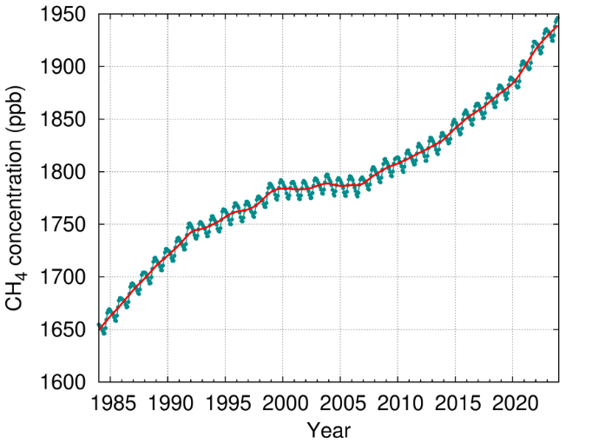
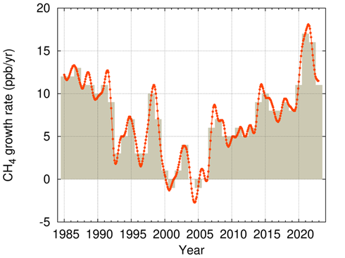
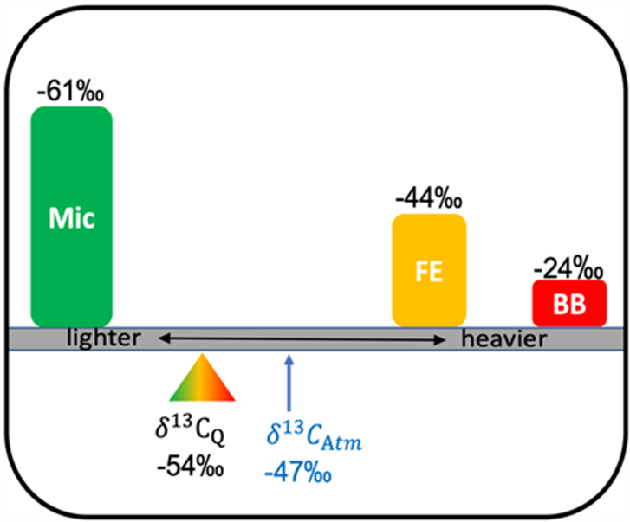
Methane (CH₄)
1934±2 ppb in 2023
11 ppb increase from 2022 to 2023
165% increase since preindustrial time (1750)
Global sources and sinks can be studied using isotopic composition of CH₄

Slide 7
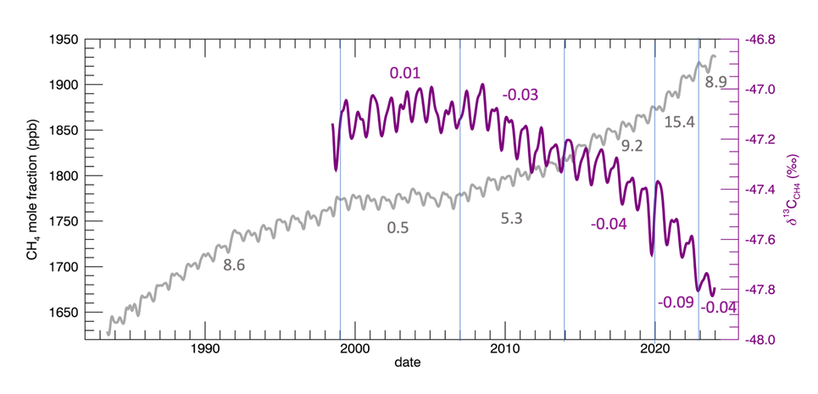
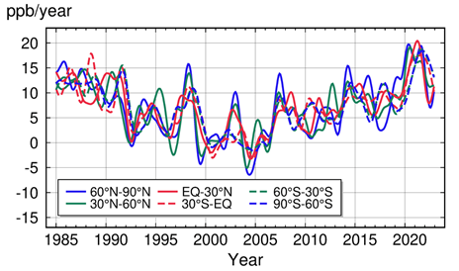
Preliminary attribution of CH₄ increases
The geographic distribution of CH₄ growth and the rapid drop in atmospheric δ¹³C_{CH4} from 2007 to 2022 suggest strong increases in isotopically light emissions (biogenic), e.g. tropical and boreal wetland areas. It was reduced in 2023.

Slide 8
Properties of Black Carbon (BC)
Black carbon, commonly known as soot, is a component of fine particulate air pollution (PM2.5). It is formed by incomplete combustion, for example of wood, waste and fossil fuels, a process which also creates carbon dioxide (CO₂), carbon monoxide, and volatile organic compounds.
Four fundamental physical properties of BC:
1. Strong visible wavelength-independent light absorption
2. Refractory with vaporization temperature near 4000 K
3. Graphitic SP2-bonded carbon with aggregate morphology
4. Insolubility in water and common organic solvents
BC is difficult to measure preciselly in the atmopshere

Slide 9
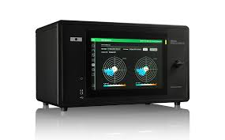
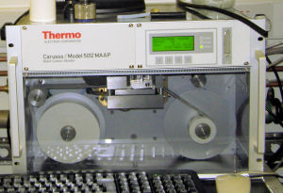
Measuring Black Carbon in the atmosphere
Equivalent black carbon (EBC):
Light-absorbing aerosol
measured as an absorption coefficient at a specific wavelength,
with typical unit Mm⁻¹
converted to a mass concentration of “black carbon”,
with typical unit μg.m⁻³,
using a chosen value of mass absorption cross-section (such as 7.5 m².g⁻¹)
Aethalometer
Multi Angle Absorption Photometer (MAAP)
Picture from University of Manchester, Centre for Atmospheric Sciences
Notes:
NB The actual mass absorption cross-section of carbonaceous particles depends strongly on their size distribution as well as the composition and the graphitic/amorphous form of the carbon,
.
AND, whether they are on a filter, which
introduces multiple scattering and shadowing effects
Several types of photometers used

Slide 10
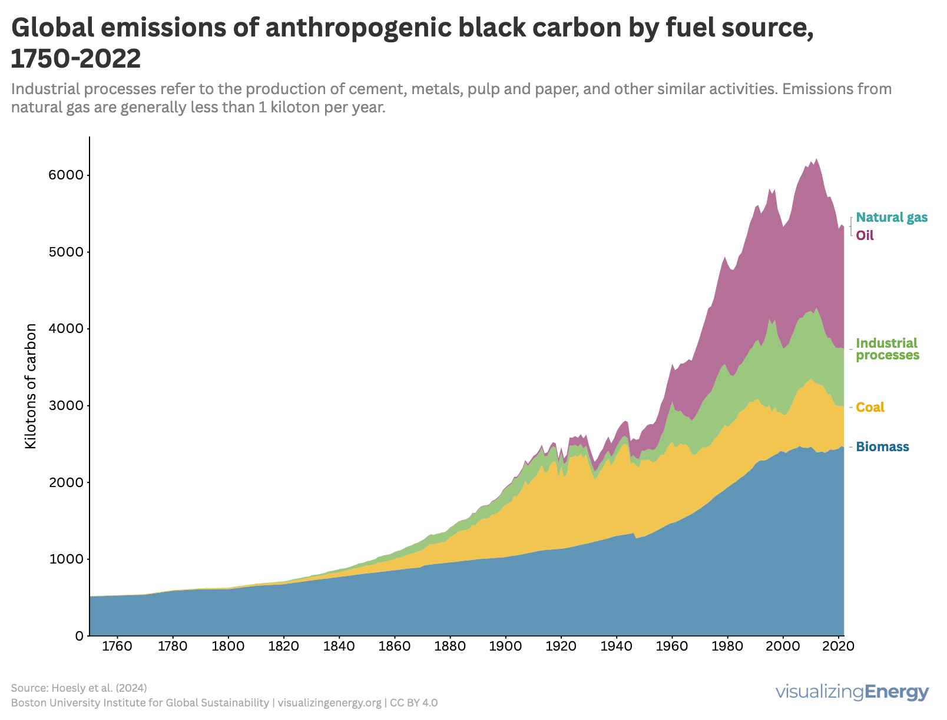
Emission is not equial to the amount of the constituent in the atmosphere

Slide 11
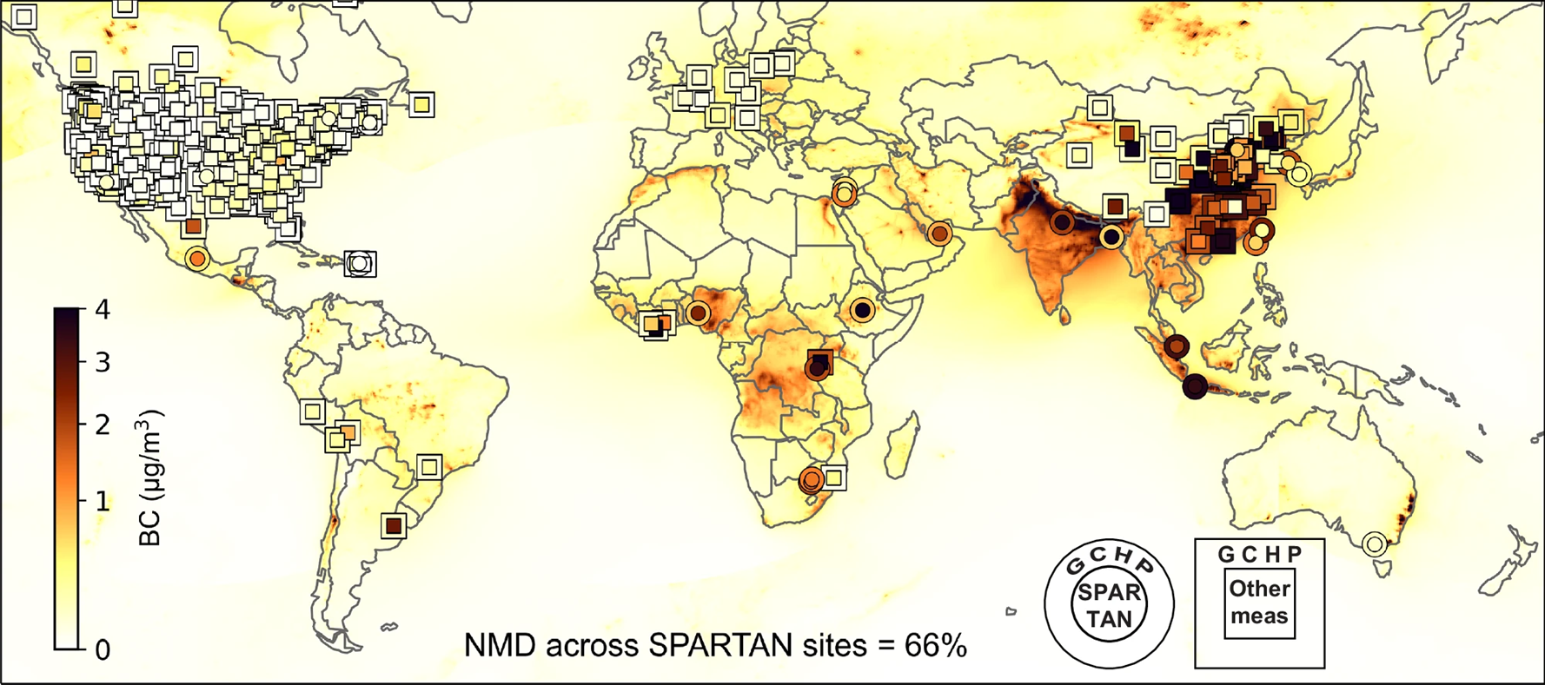
Geographic distribution of Black Carbon over 2019–2023
(Ren et al. 2025)
Ground-level BC concentrations from SPARTAN measurements over 2019–2023 and complementary measurement networks overlayed by the outputs of high-performance GEOS-Chem simulation based on emission inventory for 2019.

Slide 12
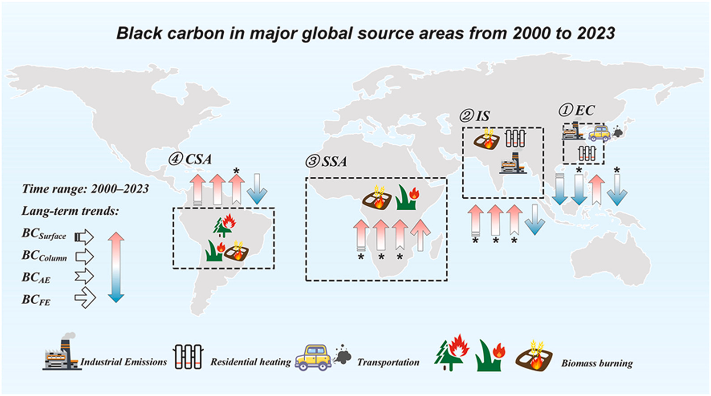
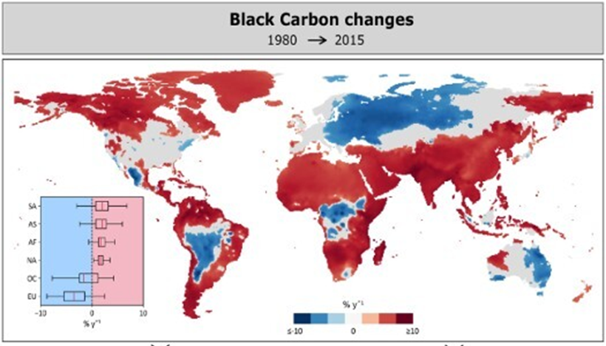
Trends in Black Carbon
Based on Modern-Era Retrospective Analysis for Research and Applications (MERRA-2)
(Ribeiro et al., 2025).
SSA: Sub-Saharan Africa, CSA: central South America; EC: Eastern China (EC); IS: the Indian Subcontinent
(Yurong Zhang et al., 2025)
Black carbon in Eastern China and Indian Subcontinent is primarily anthropogenic
Biomass burning governs black carbon in Sub-Saharan Africa and Central South America
All anthropogenic emission sectors in Sub-Saharan Africa show a marked upward trend
Notes:
Over the past 24 years, the BC surface mass concentration (BCSurface), BC column mass density (BCColumn), and BC anthropogenic emission (BCAE) were ranked from highest to lowest as follows: EC, IS, SSA, and CSA, whereas the order was reversed for BC fire emission (BCFE)

Slide 13
Questions?

